Slide 1
Seeking Higher Ground: Protecting Human Rights and Climate-Forced Relocation
Permanent People’s Tribunal on Human Rights, Fracking and Climate Change
May 2018
Dr. Robin Bronen
Alaska Institute for Justice

Slide 2
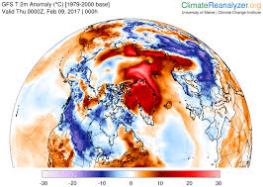
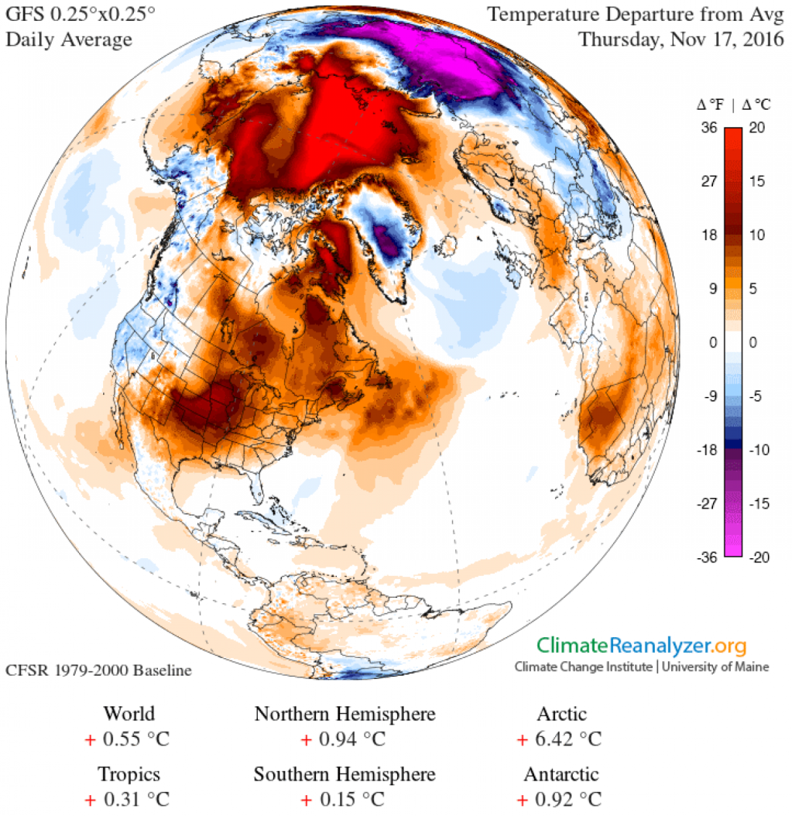
POLAR AMPLIFICATION
Feb. 2017
November 2016

Slide 3
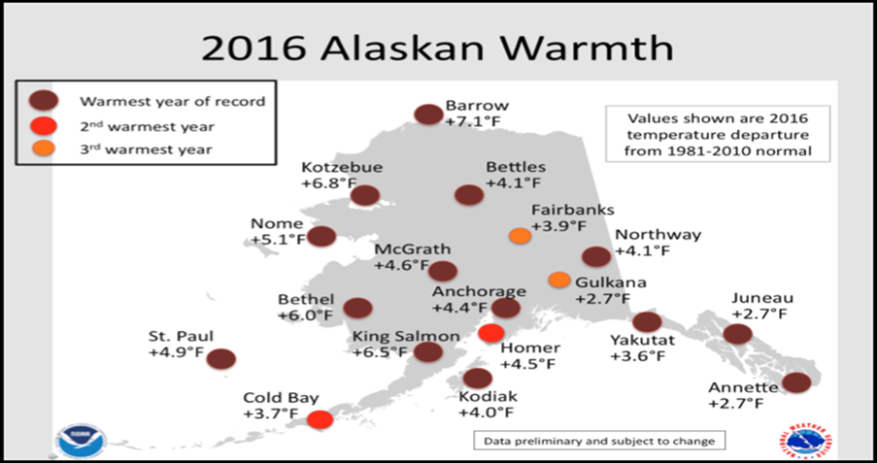
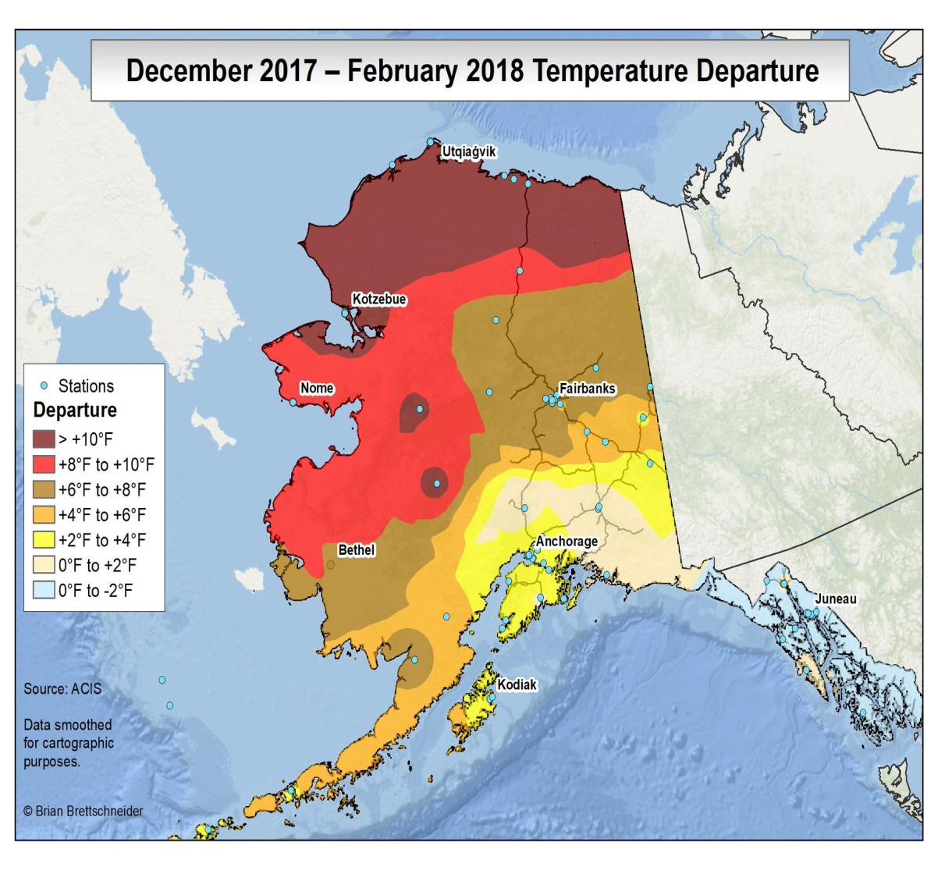

Slide 4
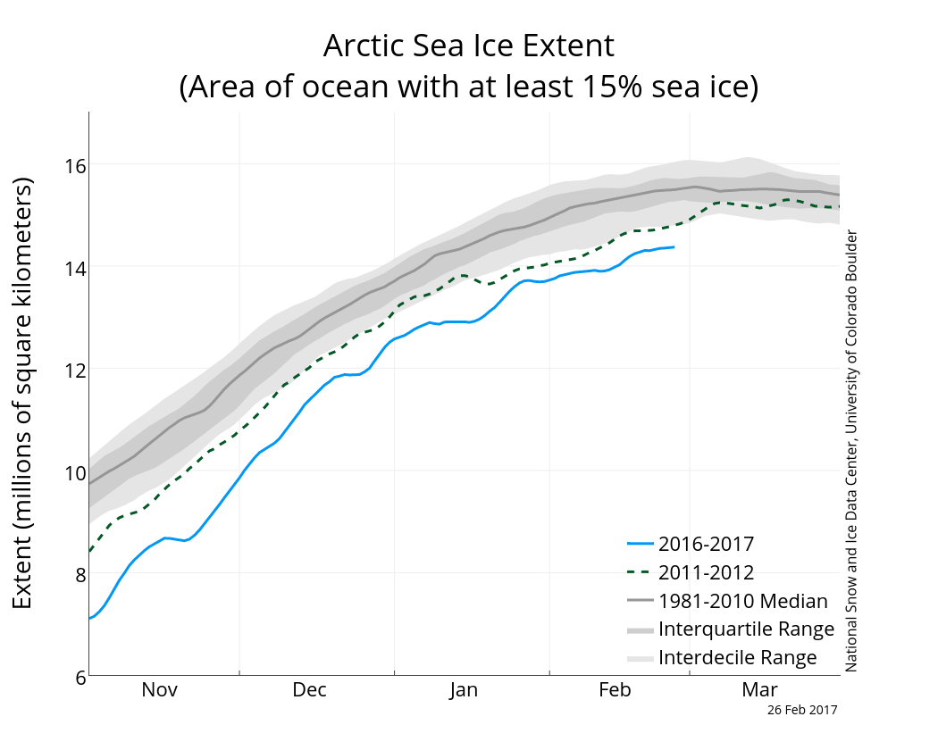
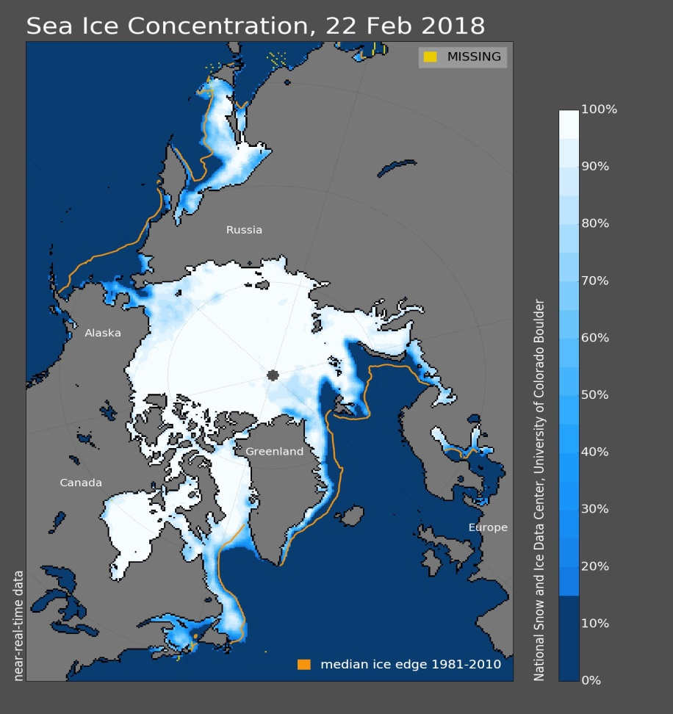
Sea Ice Extent

Slide 7
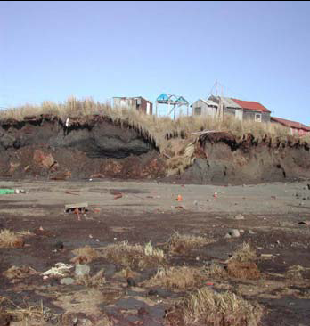
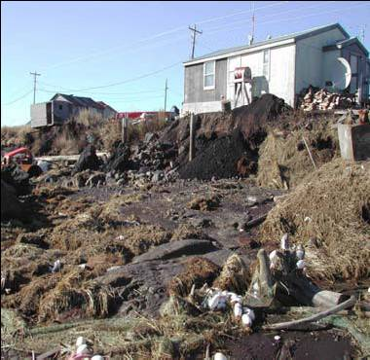
TIPPING POINTS OF COMMUNITY HABITABILITY
Photos: Frank Myoumick-Kawerak
Combination of repeated and frequent extreme weather events and slow-ongoing environmental change: decreased arctic sea ice, thawing permafrost and accelerated rates of erosion

Slide 8
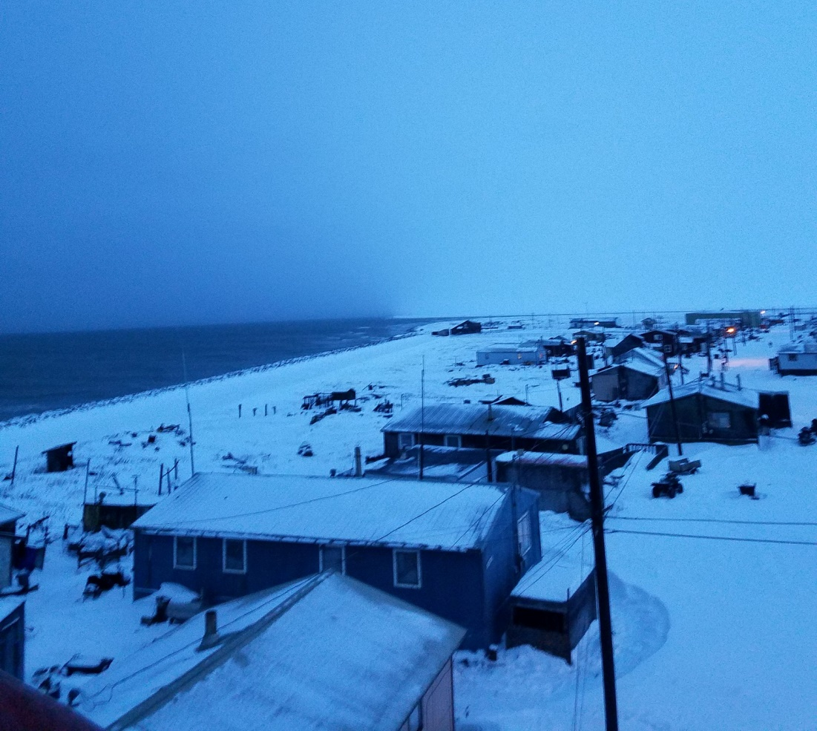
Storms Winter 2017-2018
Photos Courtesy: Golovin : Shishmaref on January 15, 2018 (Russell Toby Anungazuk Jr Nayokpuk)
and Carol Oliver

Slide 9
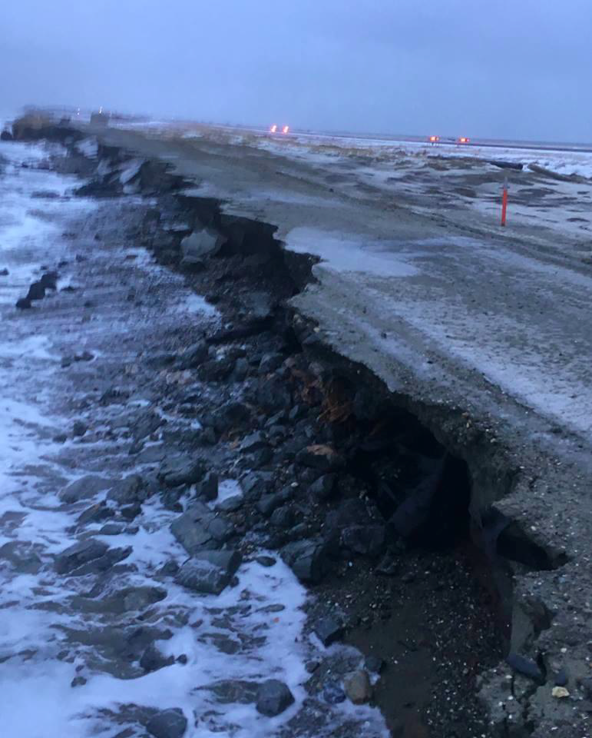
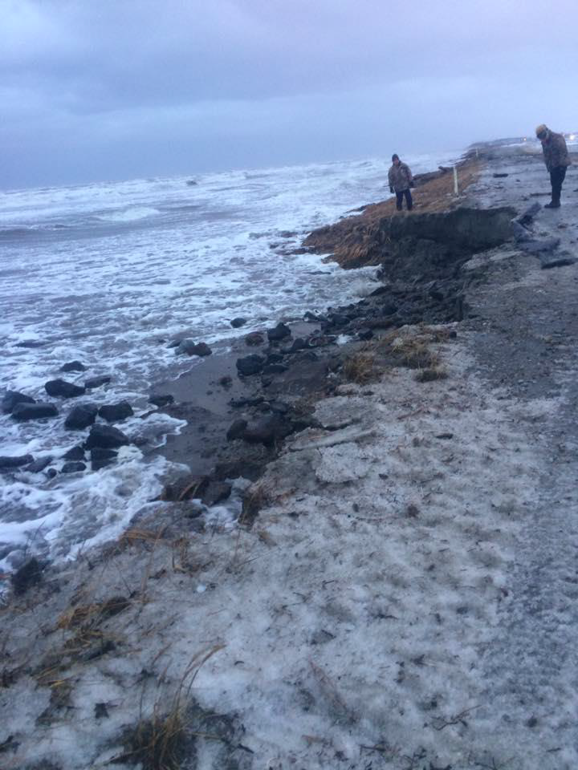
Shishmaref: Erosion to the landfill road
November 12, 2017
(Photo: Ralph Sinnok and Donna Barr)

Slide 10
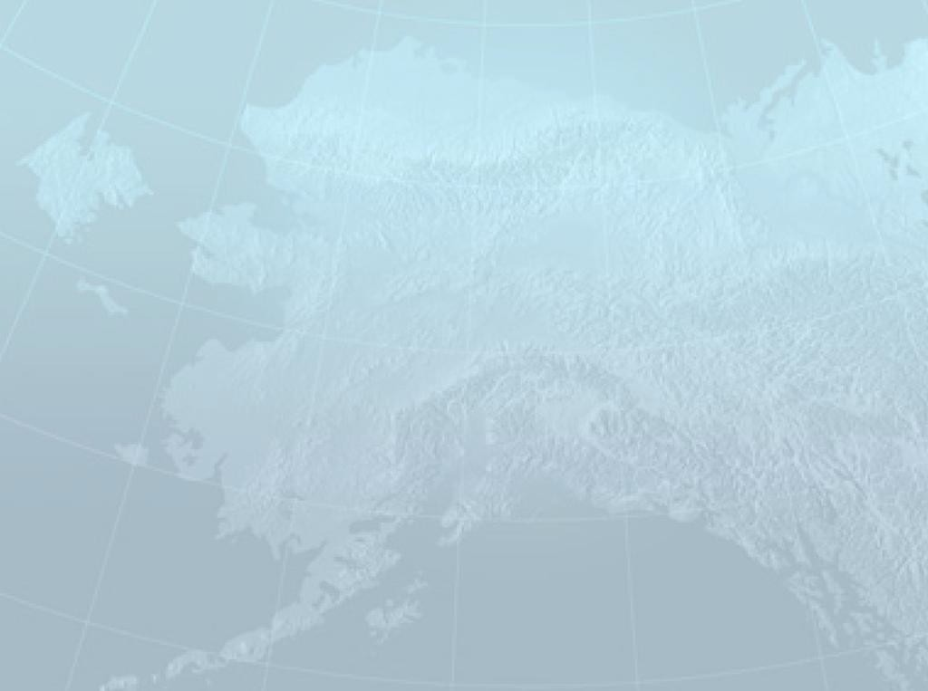
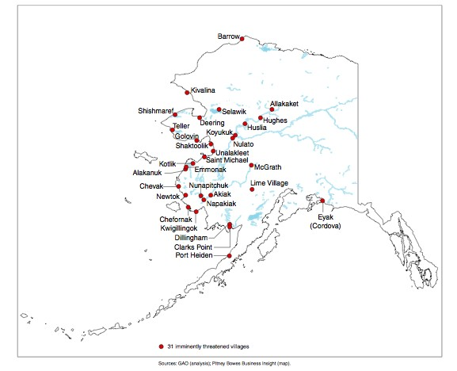
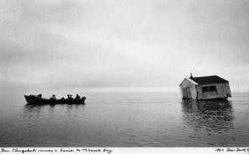
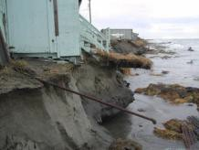



31 Villages Imminently Threatened [GAO 2009]
Alaska Communities in Peril
IMMEDIATE ACTION WORKGROUP
RECOMMENDATIONS TO THE GOVERNOR’S SUBCABINET ON CLIMATE CHANGE MARCH 2009 |  | Government Accountability Office Reports (‘03 ‘09) Immediate Action Work Group Alaska Sub-Cabinet on Climate Change Reports (‘08 & ‘09) US Army Corps of Engineers Assessment (‘09) | Alaska Baseline Erosion Assessments http://www.poa.usace.army.mil/AK E/Home.html U.S. Army Corps of Engineers 2009
RECOMMENDATIONS REPORT TO
THE GOVERNOR’S SUBCABINET
ON CHANGE CLIMATE
Requesters
United States Government Accountability Office
GAO
June 2009
ALASKA NATIVE VILLAGES
Limited Progress Has Been Made on Relocating Villages
Threatened by Flooding and Erosion
GAO-09-551
FINAL REPORT FROM THE
IMMEDIATE ACTION WORKGROUP
APRIL 17, 2008

Slide 11
WHAT IS PLANNED RELOCATION?
Voluntary
  Right to Self – Determination
Disaster Risk Reduction Strategy
  Relocation Occurs Prior to Displacement Caused by Extreme Weather Event
Human Rights Are Protected
  Right to Subsistence
  Right to Improve Livelihoods

Slide 12
THREE GOVERNANCE ISSUES
No government agency has the mandate or funding to relocate a community
No institutional framework to determine the point in time when relocation needs to occur
  How can relocation occur prior to the occurrence of an extreme weather event that displaces people?
How can human rights be protected?

Slide 13
Explore Federal role in addressing climate change-related displacement, needs of affected communities, and institutional barriers to community relocation.
The Federal Government has an opportunity to provide international leadership by establishing an institutional framework for responding to the complex challenges associated with climate-related
displacement.

Slide 14
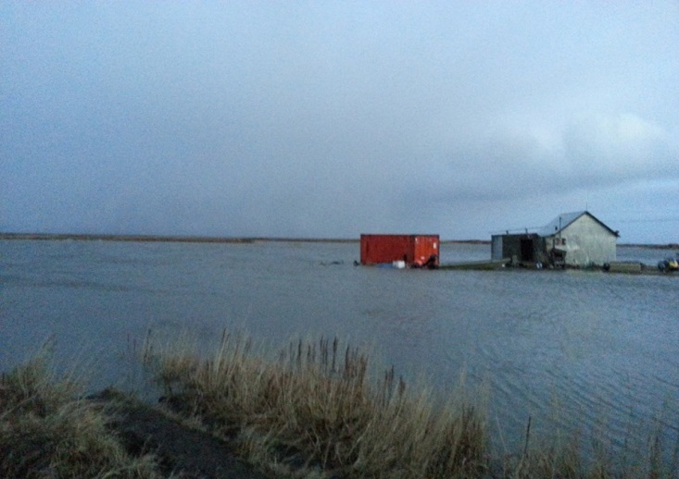
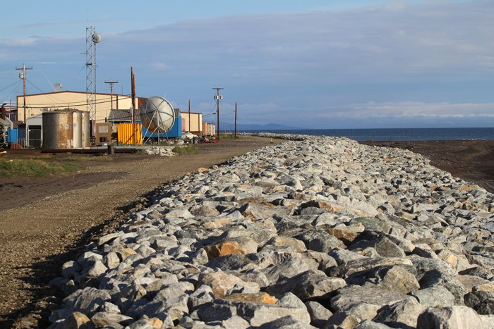
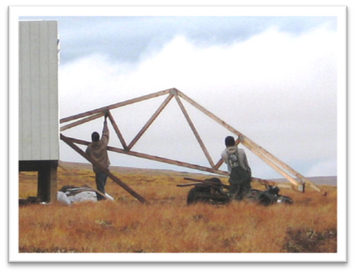
ADAPTIVE RELOCATION GOVERNANCE FRAMEWORK
HUMAN RIGHTS PROTECTIONS
  http:/ Relocation
  Indicators
Community Relocation
Protection in Place

Slide 15
Community-based monitoring
Right to Self-Determination
    Environmental change: local level information needed to make adaptation decisions;
    Impact on community health and well-being;
    Identify Government and Non-governmental agencies doing environmental monitoring ; and
    Identify programs that can provide technical assistance and funding.

Slide 16
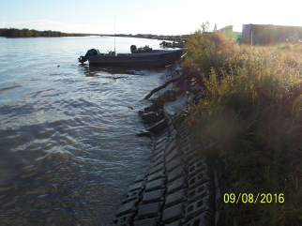
Integration of Indigenous/Local and Western Knowledge
  Storm Forecasting
  Documentation of flooding and erosion events
  Install erosion and shoreline change monitoring time lapse cameras in 5 communities
Kwigillingok: Erosion along barge landing site on Kuskokwim Bay in 2011. Yellow plastic poles are placed along the bank to measure rates of erosion.
1985 Bank erosion protection
Kotlik: Victor Tonunchuk

Slide 17
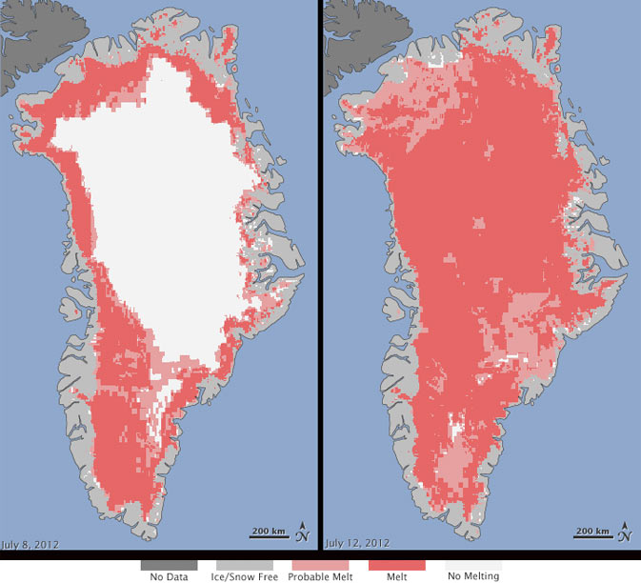
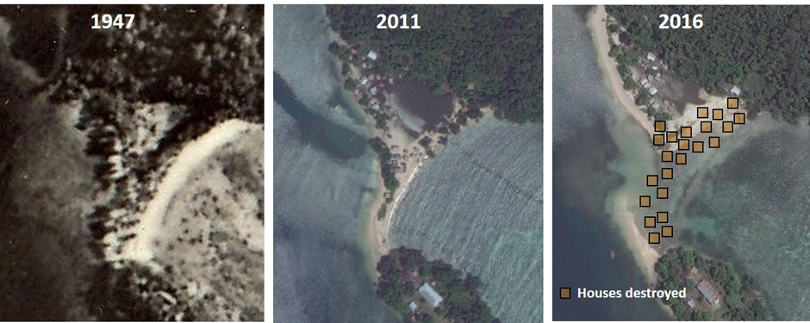
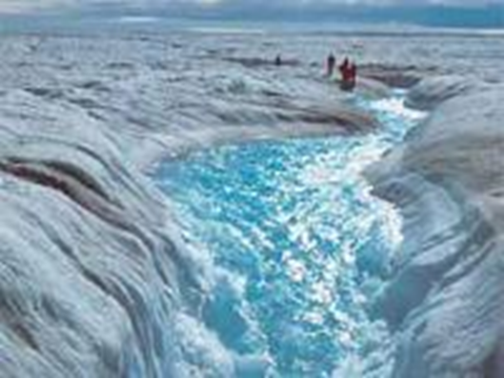
ONE PLANET- ARCTIC IMPACTS THE ENTIRE WORLD
GREENLAND ICE SHEET MELT = SEA LEVEL RISE
July 2012: 97% melt
Photo Credit: NASA
Nuatambu, Solomon Islands Aerial (1947) and satellite imagery (2011 and 2016) with 24 houses destroyed over past decade indicated on 2016 image and 10 houses remaining

Slide 18
Acknowledgements
Chinik Eskimo Community
Native Village of Elim
Native Village of Eyak
City of Kivalina
Native Village of Kivalina
Native Village of Kwigillingok
Native Village of Nelson Lagoon
Native Village of Nunapitchuk
Native Village of Port Heiden
Native Village of Kwinhagak
Native Village of Shishmaref
Native Village of Teller
Native Village of Unalakleet
Chinik Eskimo Community
Native Village of Elim
Native Village of Eyak
City of Kivalina
Native Village of Kivalina
Village of Kotlik

